Slide 1
Re-Framework Without Queues
By- Rashmi Pareek ☺

Slide 2
What is Framework
A framework is a particular set of rules, ideas, or beliefs which you use in order to deal with problems or to decide what to do.

Slide 3
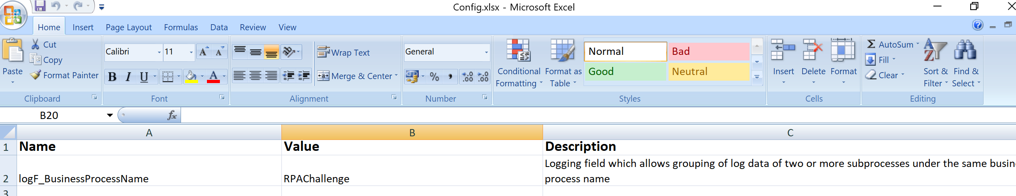
Things Needs to Change in Re-Framework When working without Queues
In Data\Config.xlsx
Change the value of logF_BusinessProcessName to your Process Name & Change the MaxRetryNumber count value as well in Constants Sheet

Slide 4
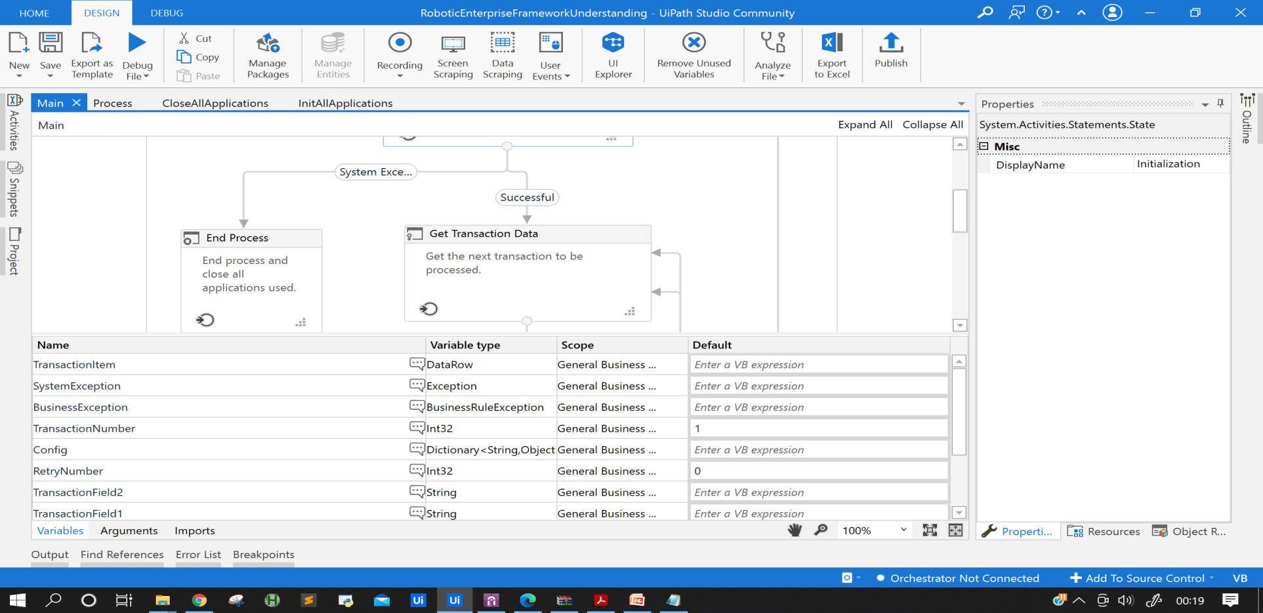
Things Needs to Change in Re-Framework When working without Queues
Change Variable from QueueItem to DataRow (Main.Xaml)

Slide 5
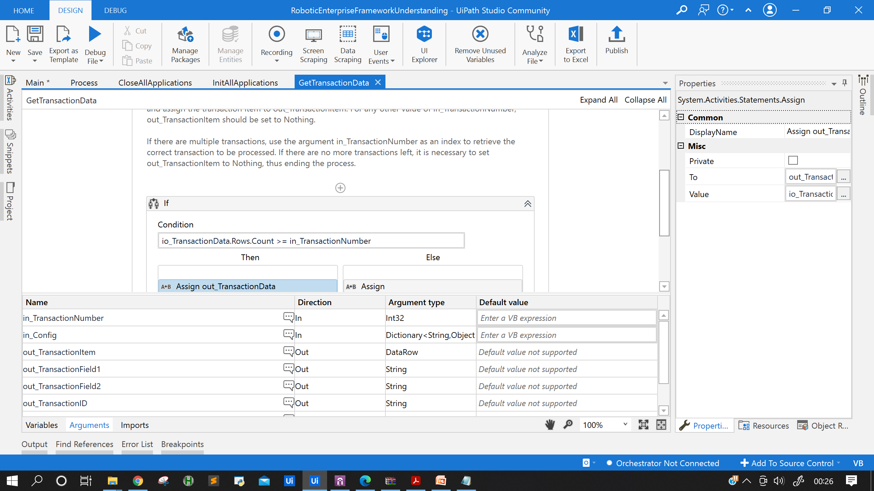
Things Needs to Change in Re-Framework When working without Queues
Change Variable from QueueItem to DataRow in GetTransactionData.Xaml

Slide 6
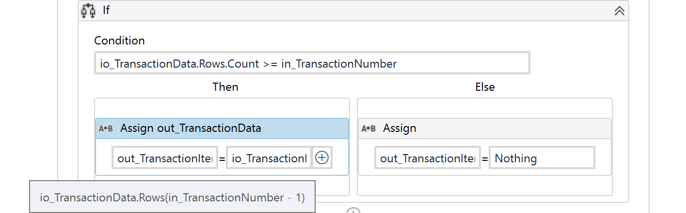
Things Needs to Change in Re-Framework When working without Queues
In GetTranscationData.Xaml Replace the if condition with
Note – io_TranscationData contains your Datatable from which you want to iterate.

Slide 7
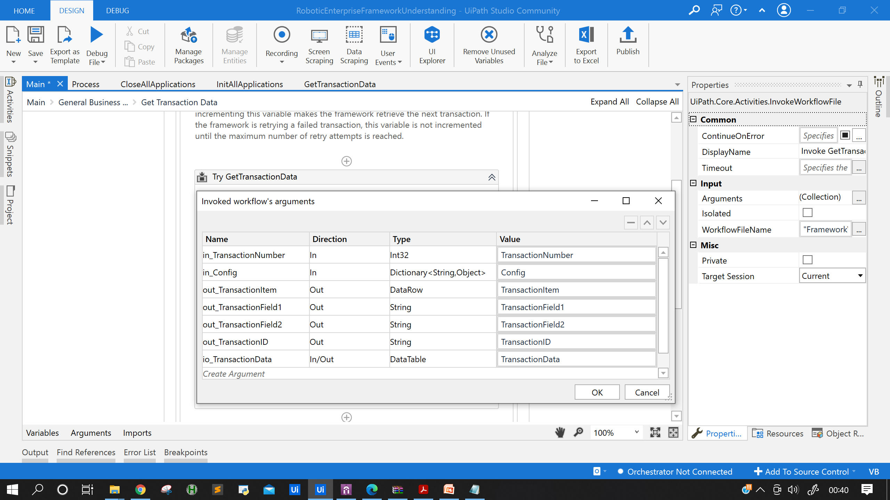
Things Needs to Change in Re-Framework When working without Queues
Change Values in Import Arguments as well- Just for FYI

Slide 8
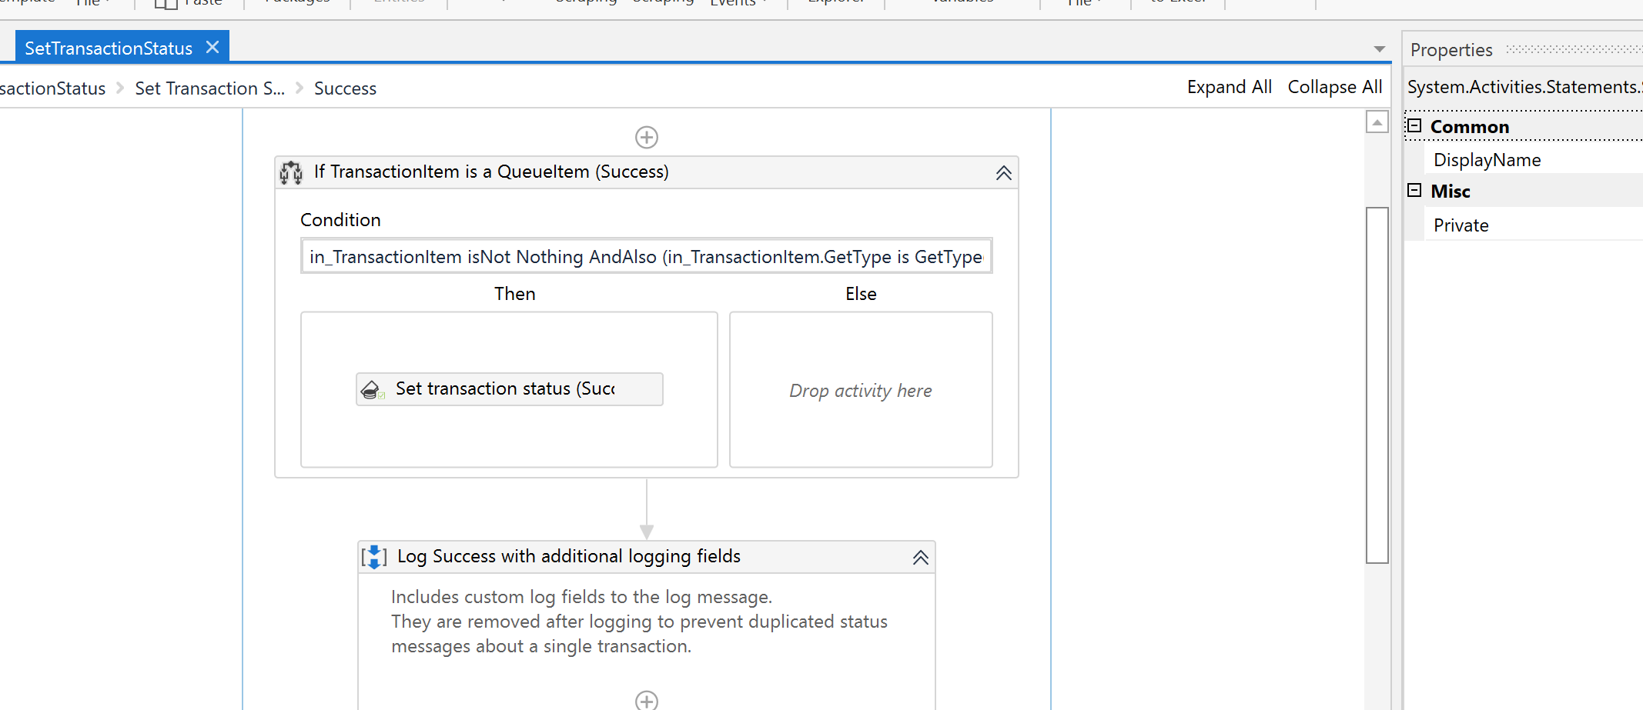
Things Needs to Change in Re-Framework When working without Queues
Remove the Set Transaction Status Activity from
Success – Business Exception – System Exception in SetTransaction Status.Xaml

Slide 9
Things Needs to Change in Re-Framework When working without Queues
You are all Set now to Run your Process :D
In case if any error symbol you are seeing than check the Import Arguments of each XAML and change the variable type accordingly.

Slide 10
Thanks and Happy Automation
For any Queries reach out to me –
YT - https://www.youtube.com/channel/UCiCRTM2HjRjKYOZsNNcFrJg
LinkedIn -
https://www.linkedin.com/in/rashmi-pareek-a7749480/
UiPath Fourm -
https://forum.uipath.com/u/rashmi

